Slide 1


Slide 2

Online
Movie
Ticket Booking
SYSTEM

Slide 3

A Project Report On “Online movie ticket booking SYSTEM” In Java Submitted to, SHIVAJI UNIVERSITY, KOLHAPUR In the partial fulfillment of award of degree BACHELOR OF SCIENCE-Information Technology (Entire) (B.Sc. I.T Part -III) Submitted by, Mr. Jilani Javed Pathan Mr. Momin Saalemahamad Sadik. Under the guidance of, Prof. P. A. Kupade Through,
The Principal,
Karmaveer Bhaurao Patil College, Urun-Islampur,
Tal - Walwa, Dist- Sangli

Slide 4
Introduction
The Online Movie Ticket Booking project in Java is a software application that provides a convenient way for users to book movie tickets online. This project aims to streamline the ticket booking process, making it easier and more efficient for both users and theatre owners. The project allows users to browse through a list of available movies, view their details such as title, genre, cast, and show timings. Users can select their preferred movie and choose a showtime that suits them. The application provides real-time information on seat availability and lets users select their desired seats from a seating layout. The project includes an admin panel that allows owners or administrators to manage movie listings, update show timings, monitor bookings, and view sales reports. The Online Movie Ticket Booking project in Java provides a user-friendly and efficient platform for booking movie tickets online. It simplifies the ticket booking process, reduces waiting time, and enhances the overall movie-going experience for users. Whether it's selecting seats, making payments, or managing bookings, this project offers a comprehensive solution for both users and theatre owners.

Slide 5
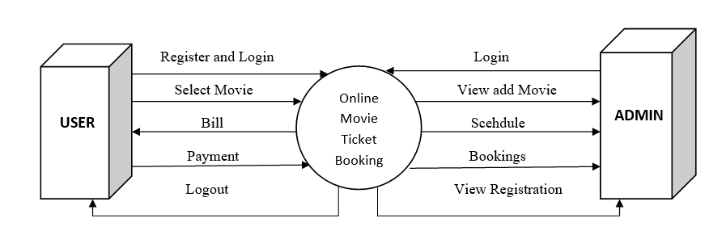
Data Flow Diagram

Slide 6
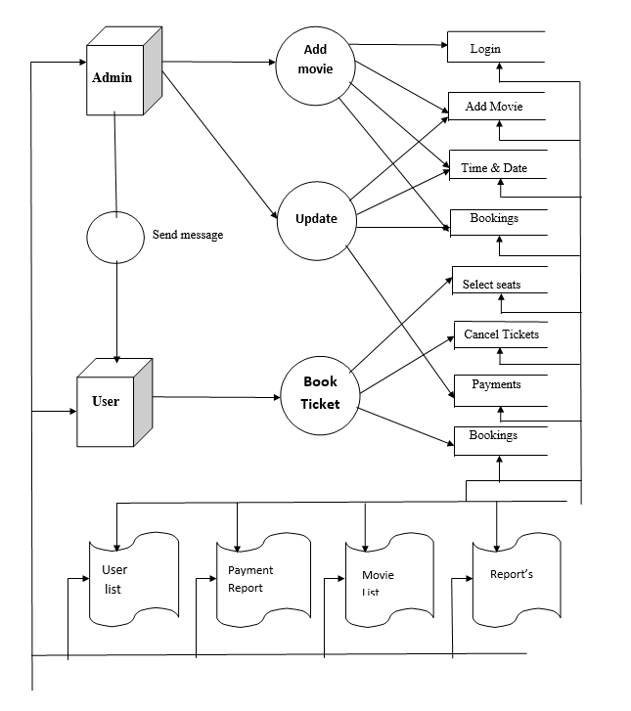
Data Flow Diagram

Slide 7
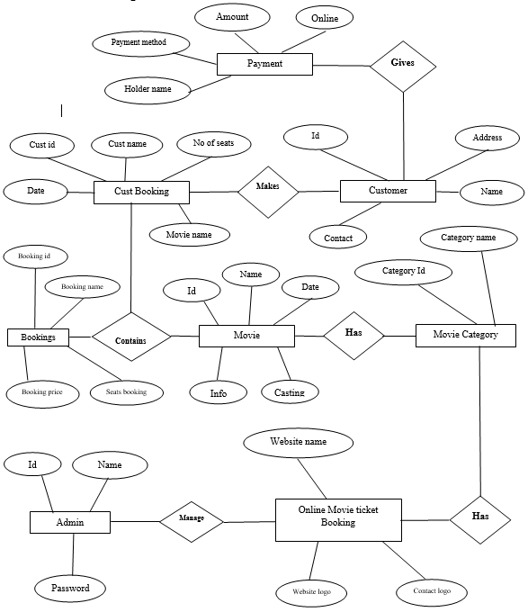
ER diagram

Slide 8
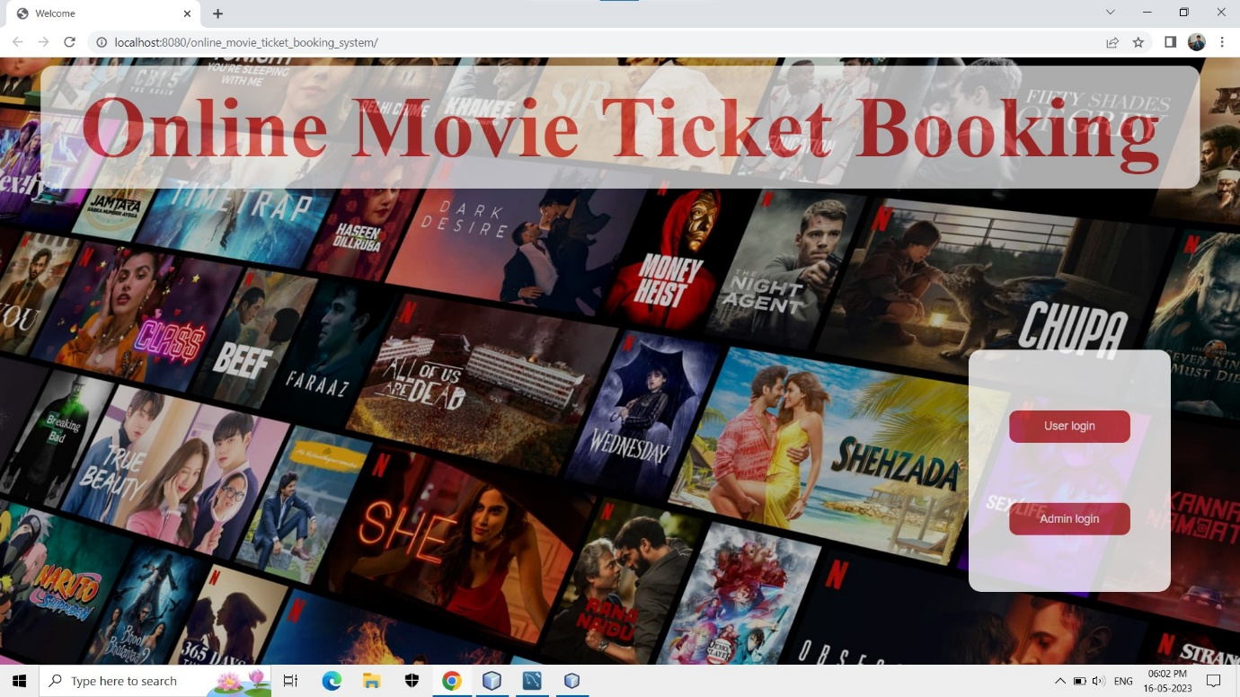
Home Page of Website

Slide 9
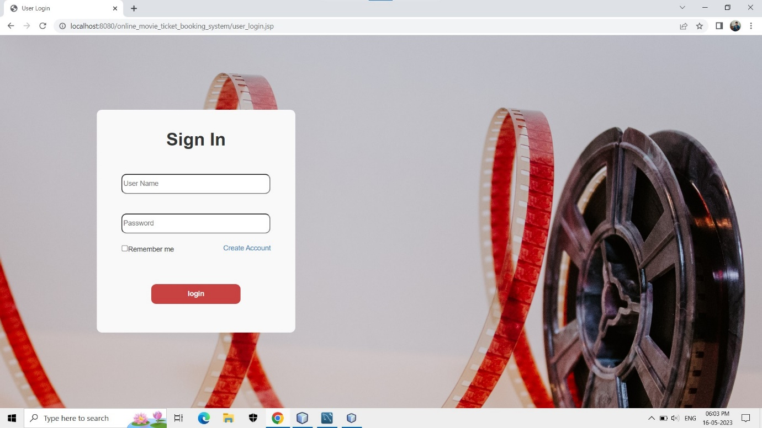
User Login

Slide 10
Input
&
Output
Screens

Slide 11
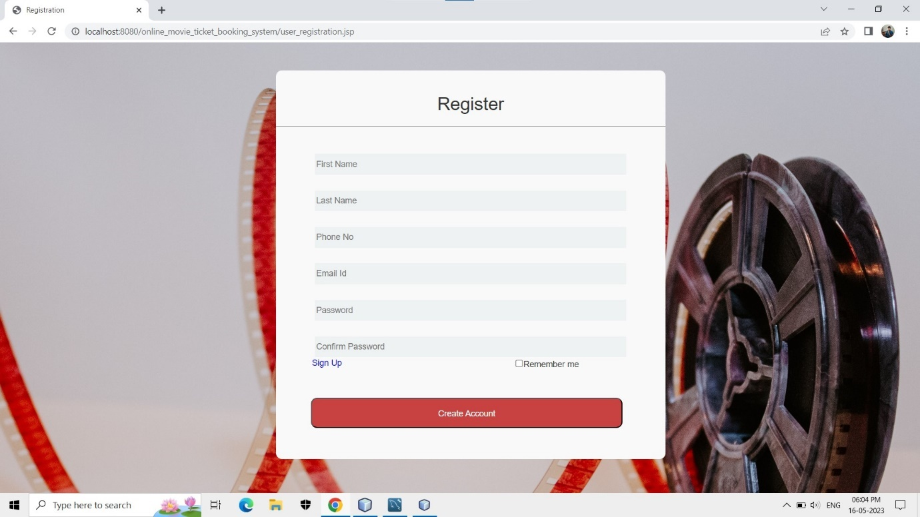
User Registration

Slide 12
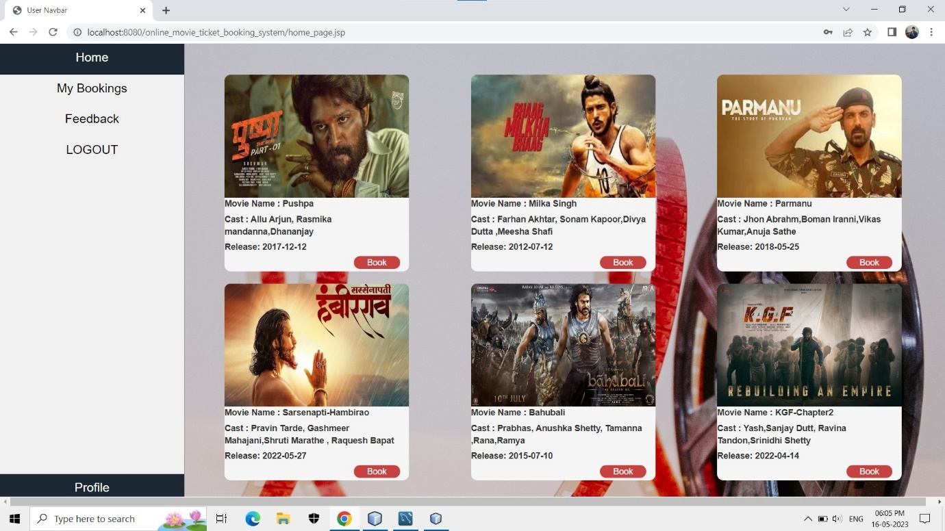
Home page

Slide 13
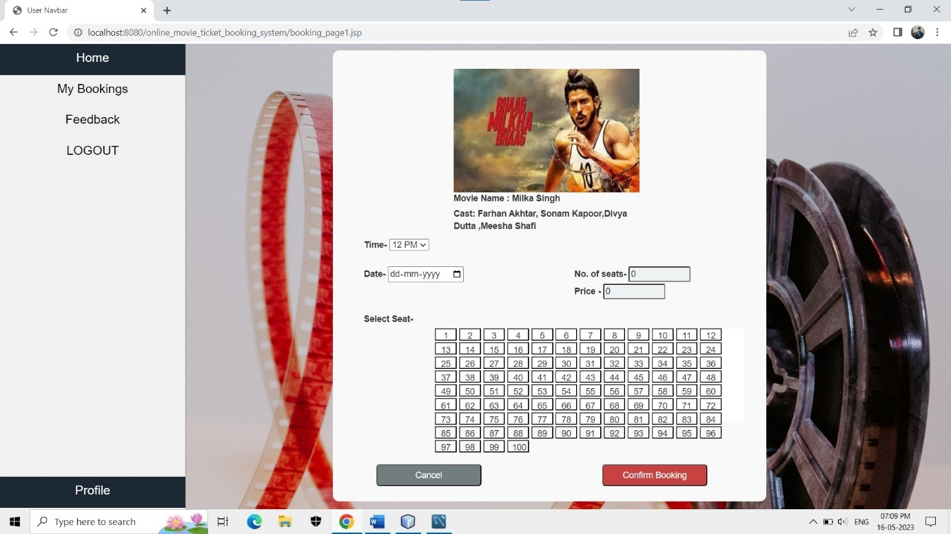
Booking Page

Slide 14
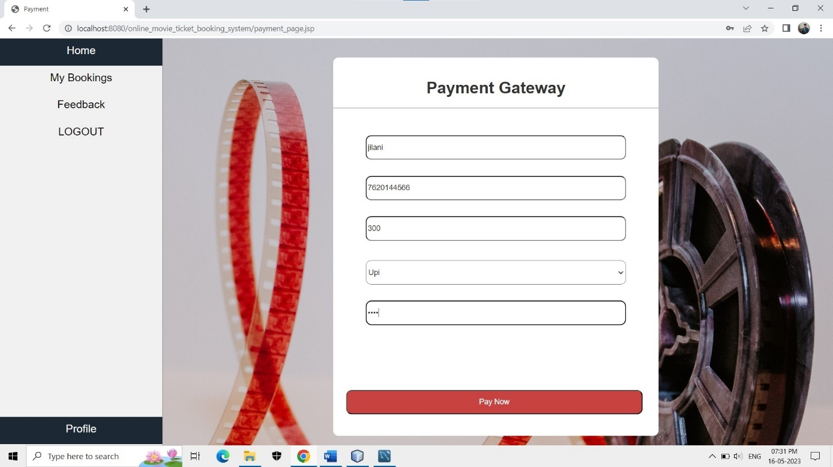
Booking Page

Slide 15
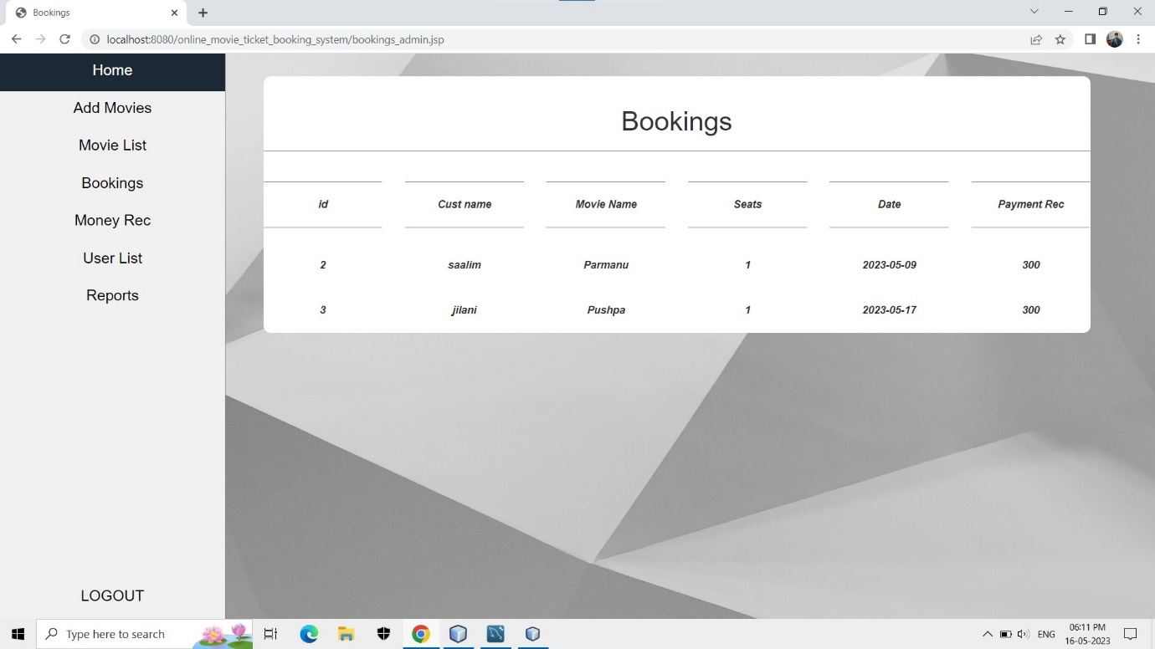
My Bookings

Slide 16
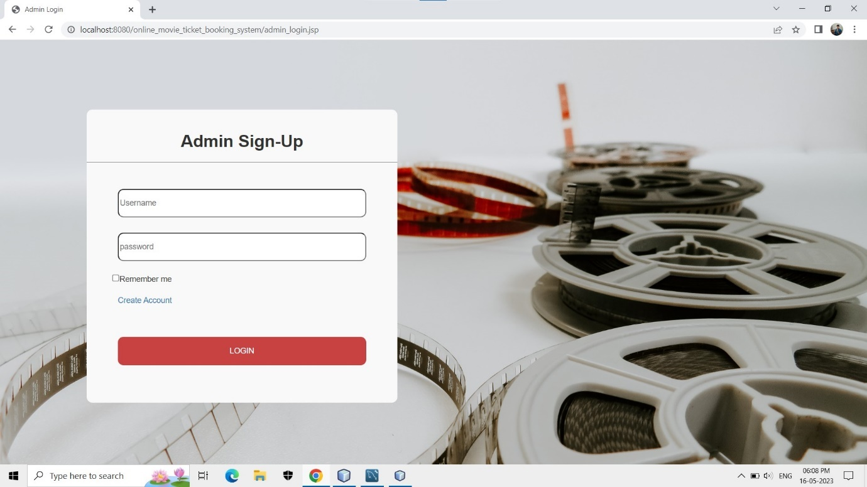
Admin Login

Slide 17
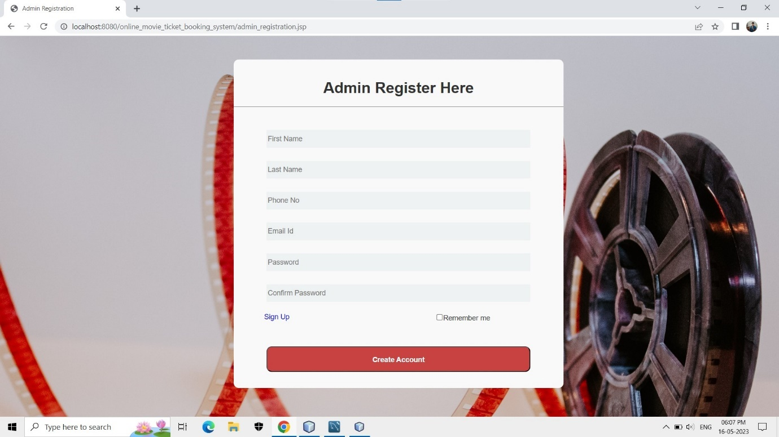
Admin Registration

Slide 18
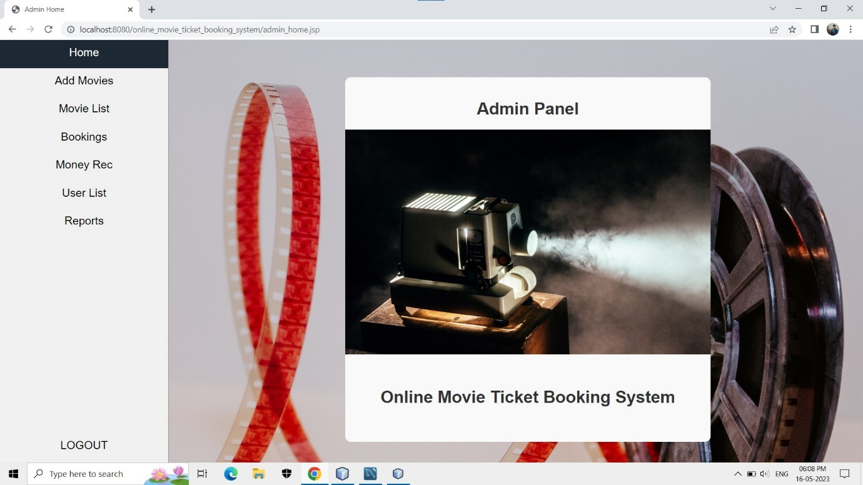
Admin Home

Slide 20
Conclusion
This project highlights the possibility to provide to manage and store the information of school to manage various details pertaining to its students. Manage Nursery Schools data very difficult that’s why we implement this project. Our project is stores data of Play group, Nursery, LKG, UKG students. We can do online registration, online submit fee, all data is visible to teachers as well as parents. Parents can do registration as well as submit fee by online. Also, one report is generated to information of students so teachers can view the status of students

Slide 21
